Slide 1
Library Management System
ISCG 5421 Programming Principles and Practice

Slide 2
Contents
Introduction
Flowcharts
UML Use Case Diagram
Database Tables
Class diagrams
GUI
Test Plan
Future Developments

Slide 3
Introduction
The project Library Management System is a library management software for monitoring and controlling basic operations such as adding new customer, new books, updating information, searching books and customers, borrowing and returning books.
It is developed in Java.
It features a familiar user interface, combined with searching options and reporting capabilities.

Slide 4
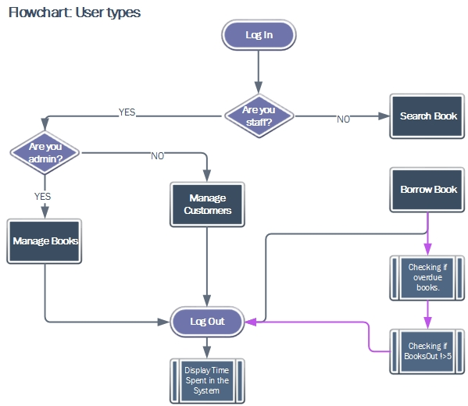
Flowcharts

Slide 5
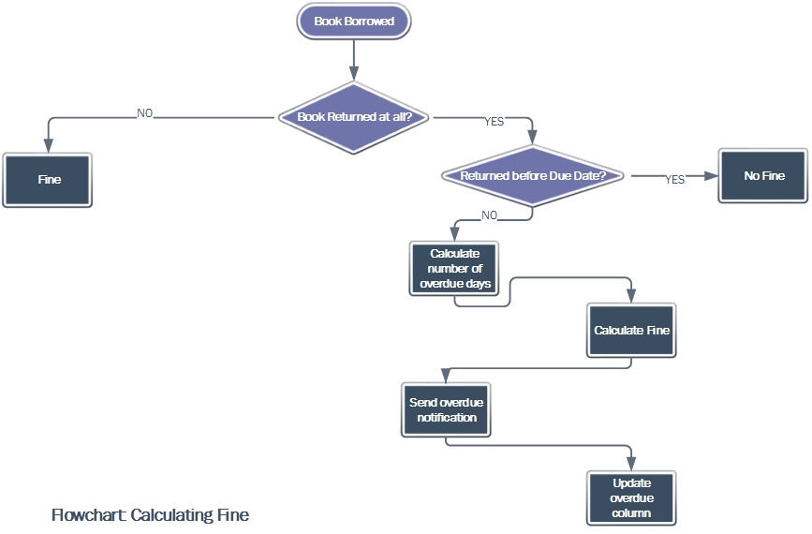
Flowchart

Slide 6
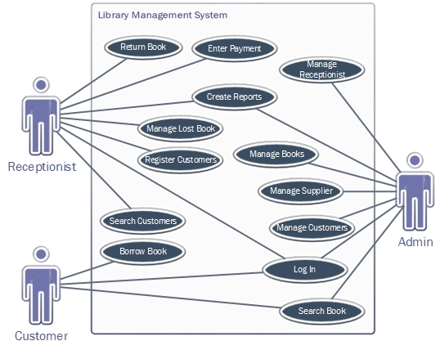
UML Use Case Diagram

Slide 7
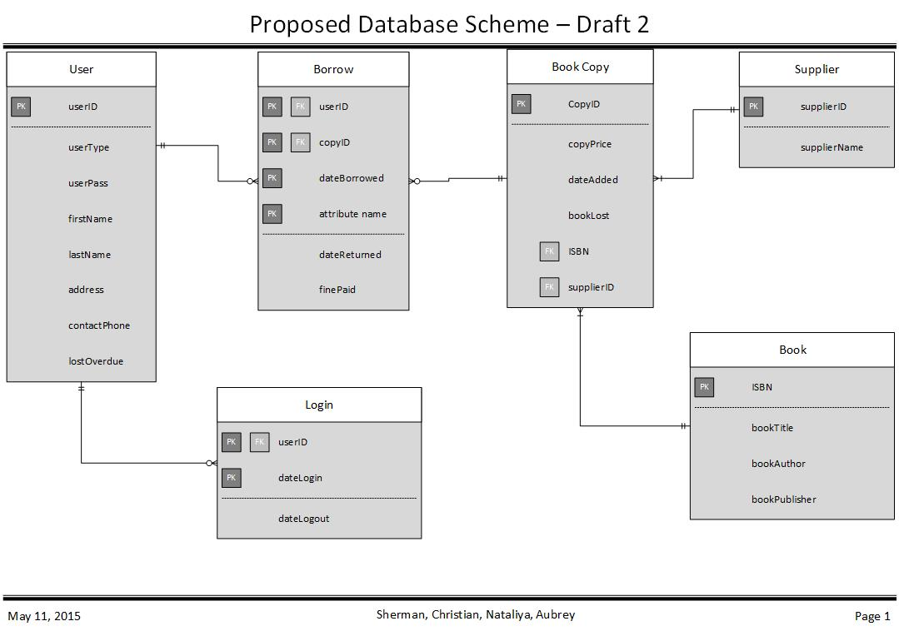
Proposed Database Scheme

Slide 8
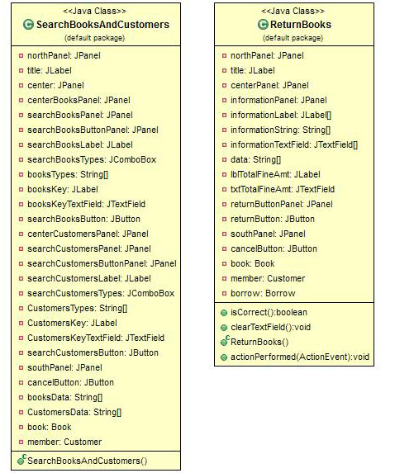
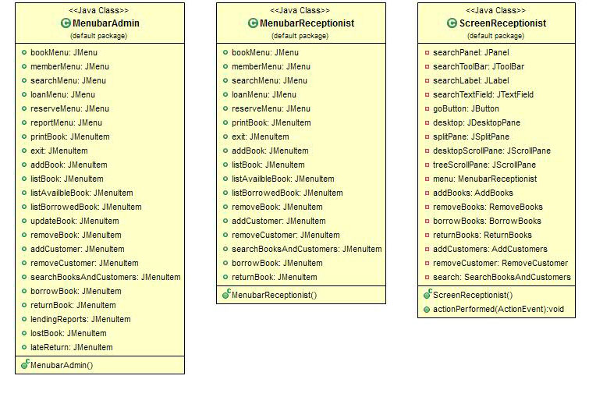
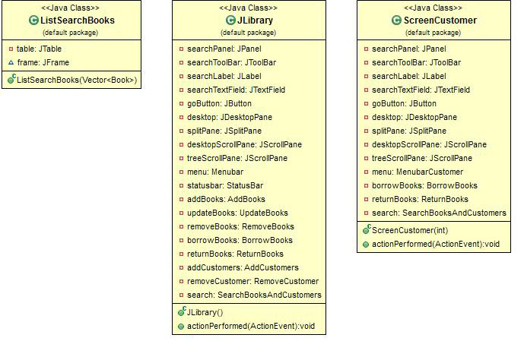
Classes
GUI Classes

Slide 9
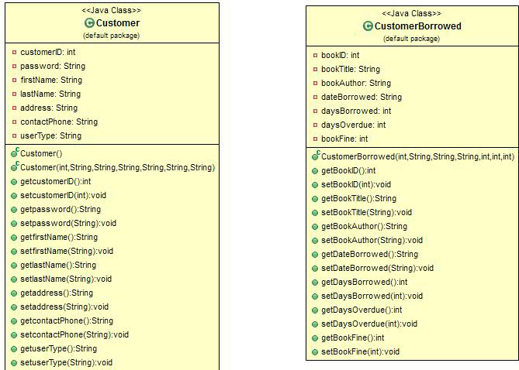
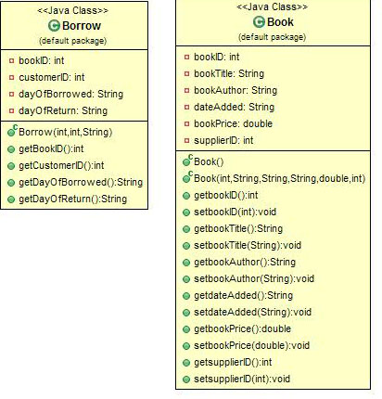
Classes
Constructor Classes

Slide 10
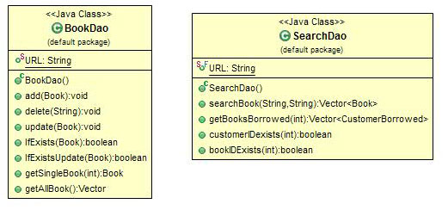
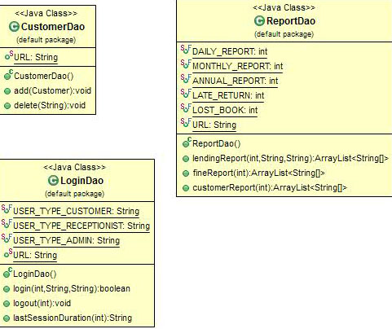
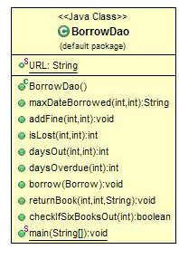
Classes
DAO Classes

Slide 11
Test Plan
The majority of the testing was undertaken within the data access object (DAO). This was due to the high chance for error when coding SQL statements. Our method for testing can be broken down into three phases.
Unit testing –DAO class.
Unit Testing –FRAME.
White box testing.

Slide 12
Unit Testing DAO
Create a main within the DAO class and create an object with dummy data.
Then call the method that would perform some action with that dummy data.
If we received an error check the exception.
If that didn’t help copy the System.out.println(query) and paste into SQLite’s execute box.
Using the information given by the SQLite error, adjust our statement repeat steps 2-5.

Slide 13
Unit Testing DAO example
public static void main(String args[]){
Book book = new Book(11,"somebook“,"James","2015-11-05",45,11); BookDao dao = new BookDao();
dao.update(book);
}
QUERY = Update Book set bookID='11', booktitle='somebook', bookAuthor='James', DateAdded='2015-11-05' bookPrice=45.0 where bookID=11
SQLException: near "bookPrice": syntax error.
From here we would revisit the query around the bookPrice and check where we went wrong -- in this case it happened to be a forgotten coma.

Slide 14
Unit Testing --FRAME
Next run the main in the frame class load the setters with some more dummy data and try again.
Public class book frame{
book.setbookTitle("somebook");
book.setbookAuthor("James");
book.setdateAdded("2015-11-05");
book.setbookID(1234);
book.setbookPrice(45);
book.setsupplierID(11);
dao.update(book);
}

Slide 15
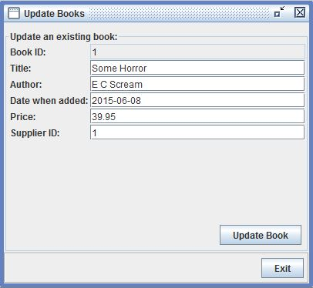
White box testing
Finally Replace the dummy data with the methods which get the text field information
Experiment with different numbers and values within GUI
bookPrice = Double.parseDouble(informationTextField[4].getText());
bookSuppID = Integer.parseInt(informationTextField[5].getText());
bookID = Integer.parseInt(informationTextField[0].getText());
book.setbookTitle(informationTextField[1].getText());
book.setbookAuthor(informationTextField[2].getText());
book.setdateAdded(informationTextField[3].getText());
book.setbookID(bookID);
book.setbookPrice(bookPrice);
book.setsupplierID(bookSuppID);

Slide 16
Looking back
Specialise earlier.
Use better code sharing software e.g. Git hub.
Better communication (sometimes we were working on the same thing without knowing it).
Become more familiar with Eclipse and how it works.

Slide 17
Looking forward
More than one book
Connect to barcode reader
More conditions surrounding user input
Change it to an actual executable program
Connect to SQL rather than SQLite
More extensive testing (we haven’t tried to break it…yet)

Slide 18
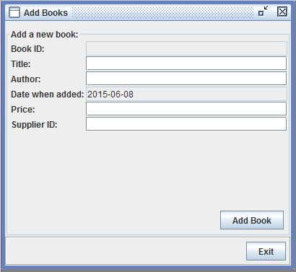
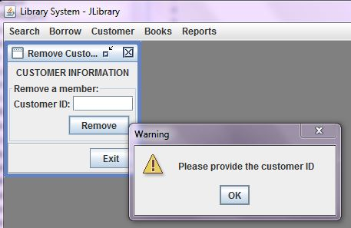
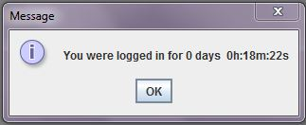
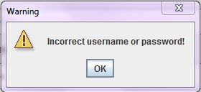
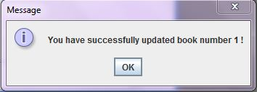
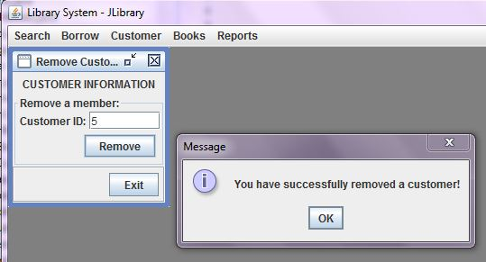
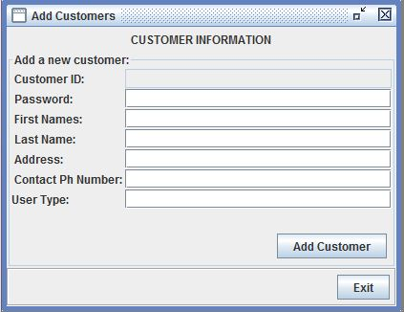
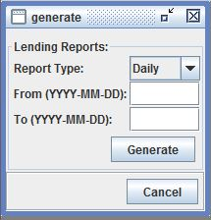
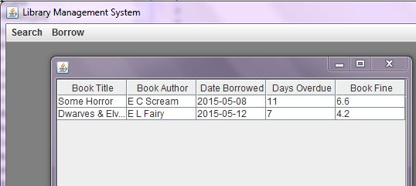
ITS OVER!!!!

